Slide 1



Compassionate Animal Adoption And E-Commerce Platform
Presented by Team Pentagons

Slide 2

Member of Group
Ansh Jain (RA2211003011867)
Aryan Gupta (RA2211003011875)
Dwij Bishnoi (RA2211003011316)
Neel Bishnoi (RA2211003011397)
Sawai Singh Rajpurohit (RA2211003011865)

Slide 3

Introduction
We are dedicated to creating a compassionate online platform where individuals can embrace the opportunity to adopt not only stray animals but also ex-military animals. Our commitment extends to delivering comprehensive profiles for each unique animal, encompassing crucial details such as medical history and other pertinent information.
2 section is about selling products like food pdts, animal gromming care kit , multi-vitamins,pet supplements and Leash Products etc

Slide 4




Project Overview
Our e-commerce platform will offer a diverse range of products and services tailored to the needs of pet owners, providing them with convenient access to essentials and specialty items. Furthermore, we're committed to utilizing innovative technologies to enhance user experience and streamline the adoption process, ensuring a seamless journey for both adopters and shelter animals.

Slide 5


Project Sections
Adoption
Shopping
Blog
Donation

Slide 6
Why you should use our website?
Yes, while renowned e-commerce platforms like Amazon offer pet-related products, they often lack comprehensive options for nutrition and healthcare supplies. Therefore, we are dedicated to bridging this gap by ensuring that our platform offers a wide array of nutritional and healthcare products specifically tailored to meet the needs of pets. Our commitment lies in providing customers with access to all essential items necessary for the well-being of their beloved pets.

Slide 7
How we’ll promote our website?
In today's world, social media stands as the most influential platform. We will harness the power of content marketing, email marketing, and employ search engine optimization techniques to maximize our reach and impact. Additionally, we will encourage customers who have adopted through our website to promote our services by providing at least seven recommendations to others through social media or word-of-mouth publicity

Slide 8


Benefits
Save Lives: By adopting from shelters, users directly contribute to reducing the homeless pet population and saving animals' lives.
Companion Matching: Provide a platform for users to find the perfect companion by matching their preferences, lifestyle, and needs with suitable shelter animals.
Support Animal Welfare: Users support animal welfare organizations and shelters by adopting, helping them continue their crucial work in rescuing and caring for animals in need.
Affordable Adoption Fees: Offer affordable adoption fees compared to purchasing pets from breeders, making it accessible for more people to adopt and provide loving homes for shelter animals.

Slide 9
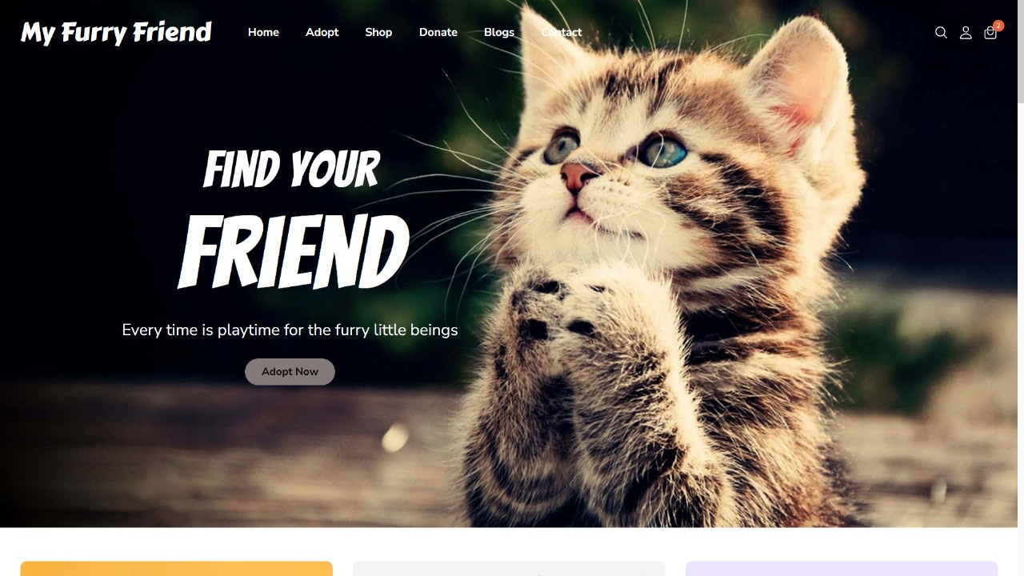
Pictorial Representation
Our project consist of 4 Sections:-
Adopt
Shop
Donate
Blog

Slide 10
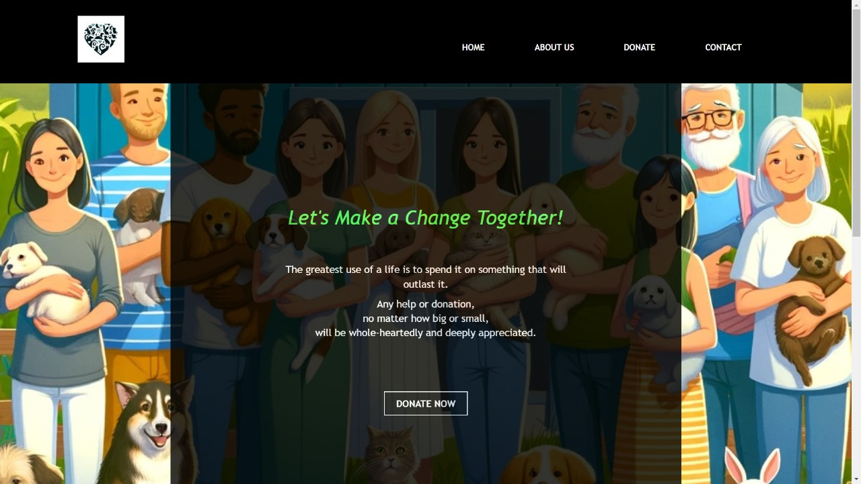
Donation
Section

Slide 11
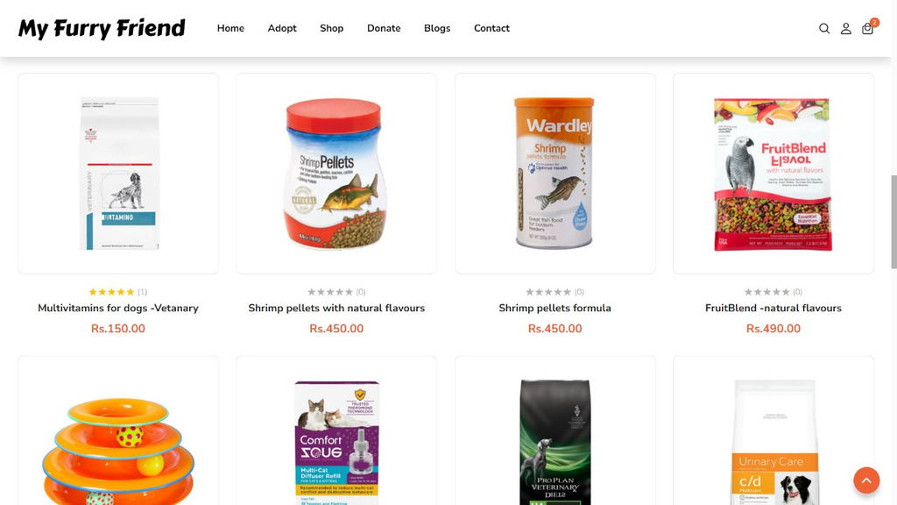
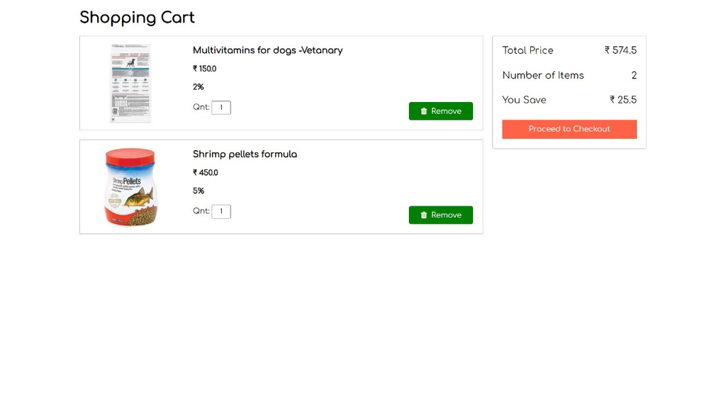
Shop Section
Shopping Cart

Slide 12
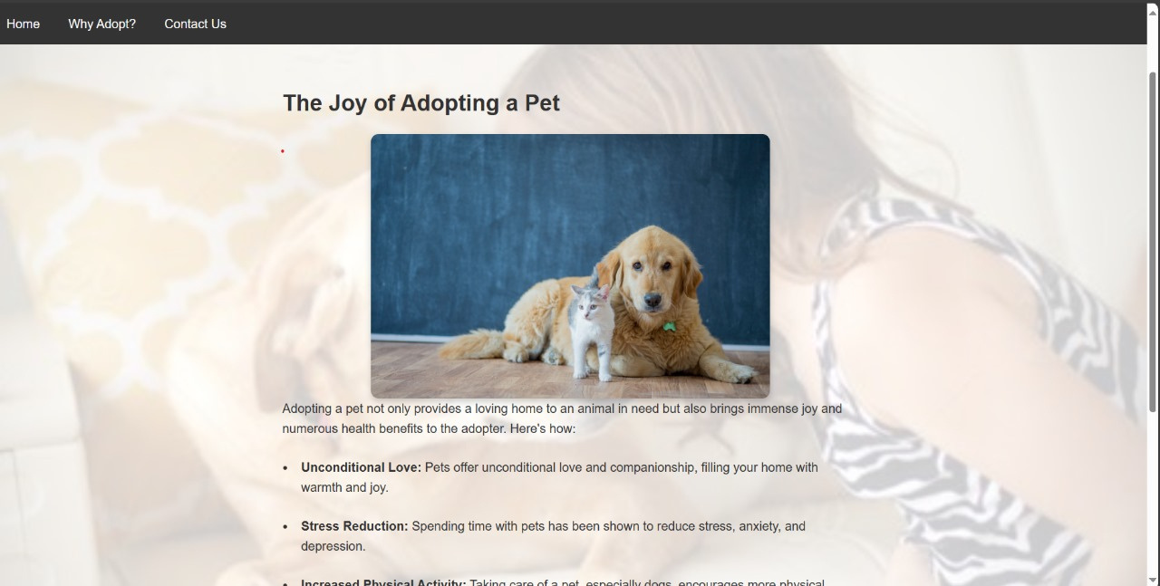
Blog Space

Slide 13

Conclusion
In summary, our website serves as a hub for connecting shelter animals with loving homes and providing essential pet products. By streamlining the adoption process and offering quality goods, we aim to enrich the lives of pets and their owners while supporting animal welfare. With our platform, we're making it easier for everyone to find their perfect pet companion and access the resources they need for a fulfilling pet ownership experience.

Slide 14

Thank
You!

